Slide 1
AVL-Trees (Part 2)
COMP171

Slide 2
A warm-up exercise …
Create a BST from a sequence,
  A, B, C, D, E, F, G, H
Create a AVL tree for the same sequence.

Slide 3

More about Rotations
When the AVL property is lost we can rebalance the tree via rotations
Single Right Rotation (SRR)
  Performed when A is unbalanced to the left (the left subtree is 2 higher than the right subtree) and B is left-heavy (the left subtree of B is 1 higher than the right subtree of B).
A
SRR at A
B
B
T3
T1
A
T1
T2
T2
T3

Slide 4

Rotations
Single Left Rotation (SLR)
  performed when A is unbalanced to the right (the right subtree is 2 higher than the left subtree) and B is right-heavy (the right subtree of B is 1 higher than the left subtree of B).
A
SLR at A
B
T1
B
A
T3
T2
T3
T1
T2

Slide 5
Rotations
Double Left Rotation (DLR)
  Performed when C is unbalanced to the left (the left subtree is 2 higher than the right subtree), A is right-heavy (the right subtree of A is 1 higher than the left subtree of A)
  Consists of a single left rotation at node A, followed by a single right at node C
C
SLR at A
C
SRR at C
B
A
T4
B
T4
A
C
T1
B
A
T3
T1
T2
T3
T4
A is balanced
T2
T3
T1
T2
DLR = SLR + SRR
Intermediate step, get B

Slide 6
Rotations
Double Right Rotation (DRR)
  Performed when A is unbalanced to the right (the right subtree is 2 higher than the left subtree), C is left-heavy (the left subtree of C is 1 higher than the right subtree of C)
  Consists of a single right rotation at node C, followed by a single left rotation at node A
A
SRR at C
A
SLR at A
B
T1
C
T1
B
A
C
B
T4
T2
C
T1
T2
T3
T4
T2
T3
T3
T4
DRR = SRR + SLR

Slide 7

Insertion Analysis
logN
Insert the new key as a new leaf just as in ordinary binary search tree: O(logN)
Then trace the path from the new leaf towards the root, for each node x encountered: O(logN)
  Check height difference: O(1)
  If satisfies AVL property, proceed to next node: O(1)
  If not, perform a rotation: O(1)
The insertion stops when
  A single rotation is performed
  Or, we’ve checked all nodes in the path
Time complexity for insertion O(logN)

Slide 8
class AVL {
public:
AVL();
AVL(const AVL& a);
~AVL();
bool empty() const;
bool search(const double x);
void insert(const double x);
void remove(const double x);
private:
Struct Node {
double element;
Node* left;
Node* right;
Node* parent;
Node(…) {…}; // constructuro for Node
}
Node* root;
int height(Node* t) const;
void insert(const double x, Node*& t) const; // recursive function
void singleLeftRotation(Node*& k2);
void singleRightRotation(Node*& k2);
void doubleLeftRotation(Node*& k3);
void doubleRightRotation(Node*& k3);
void delete(…)
}
Implementation:

Slide 9
Deletion from AVL Tree
Delete a node x as in ordinary binary search tree
  Note that the last (deepest) node in a tree deleted is a leaf or a node with one child
Then trace the path from the new leaf towards the root
For each node x encountered, check if heights of left(x) and right(x) differ by at most 1.
  If yes, proceed to parent(x)
  If no, perform an appropriate rotation at x Continue to trace the path until we reach the root

Slide 10
Deletion Example 1
20
20
10
35
15
35
5
15
25
40
10
18
25
40
18
30
38
45
30
38
45
50
50
Single Rotation
Delete 5, Node 10 is unbalanced

Slide 11
Cont’d
20
35
15
35
20
40
10
18
25
40
15
25
38
45
30
38
45
10
18
30
50
Continue to check parents
Oops!! Node 20 is unbalanced!!
50
Single Rotation
For deletion, after rotation, we need to continue tracing upward to see if AVL-tree property is violated at other node.
Different from insertion!

Slide 12
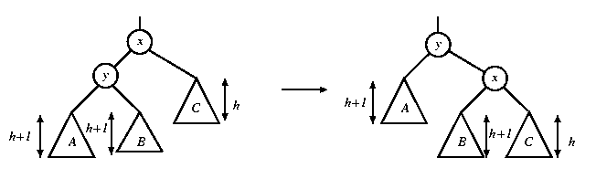
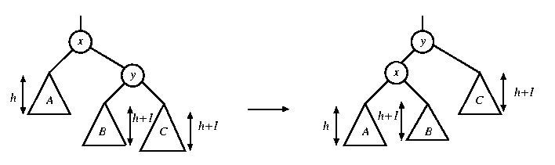
Rotation in Deletion
The rotation strategies (single or double) we learned can be reused here
Except for one new case: two subtrees of y are of the same height
rotate with left child
rotate with right child

Slide 13
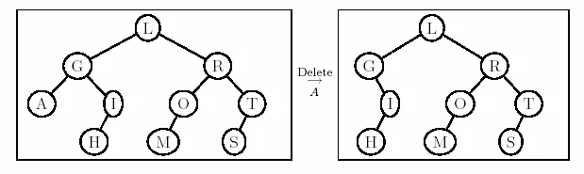
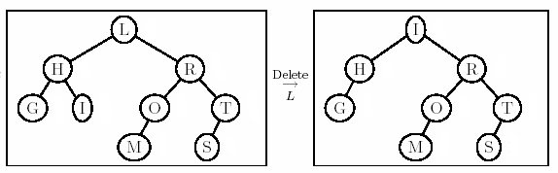
Deletion Example 2
Right most child of left subtree
Double rotation

Slide 14
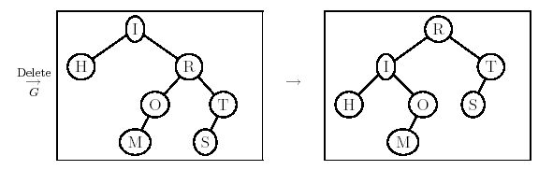
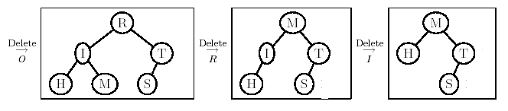
Example 2 Cont’d
New case

